Slide 1

Just-in-Time Intervention
Hosuk Choi, Matt Yang, Mia Zhao, Attush Dhakal,
Aashay Amin, Saurabh Chatterjee, Rachel Paul

Slide 2
Introduction

Slide 3
Team Members
Saurabh Chatterjee - Model Training
Rachel Paul - Model Training
Huimin Zhao - Model Training
Aashay Amin - Web Dev (back end)
Attush Dhakal - Web Dev (back/front end)
Hosuk Choi - Web Dev (front end)
Matthew Yang - Mixed (Project Manager)

Slide 4
Introduction (Overview)
We have access to a lot of data from Georgia Tech’s MOOCs
Clickstream data
Assignment data
Completion data
etc.
Our team’s ultimate goal is to both gain insight into what drives student success and to create a tool that can deliver our results for students and professors to use
This analysis has been done before, at a preliminary level (Gardner and Brooks)

Slide 5
Introduction (Progress)
Data Modeling Team - Working on data-driven insights
Data cleanup
Null value removal
Predictions: Completion Percentage
Interesting data-driven insights!
App Development Team - Working on creating a tool for students
Mockup final website
Phases for this semester
Backend connection to database
Additional front end features

Slide 6
Data Modeling Team

Slide 7
Data Modeling Team: Goal
As a part of Just In Time Intervention team, in previous semesters we have replicated Gardner & Brooks work for an edX Course to predict grades.
This semester we are exploring a different MOOC course data to evaluate the impact of clickstream data on predicting course progress and also applying the predictive modeling techniques mentioned in the paper to find the best predictive model for the problem.
Input: Demographics data and Clickstream data(like Video Load, Problem Grade) from a MOOC course.
Target Output: Percentage Progress

Slide 8
Progress Since Last Presentation
Explore & implement Null removal techniques and find the best approach to remove null values from various input variables.
Explore & implement outlier removal techniques and find the best approach to remove outliers from the data.
Find interesting data Insights from the given MOOC data set.
Find best features based on correlation of input variables with output variable.

Slide 9
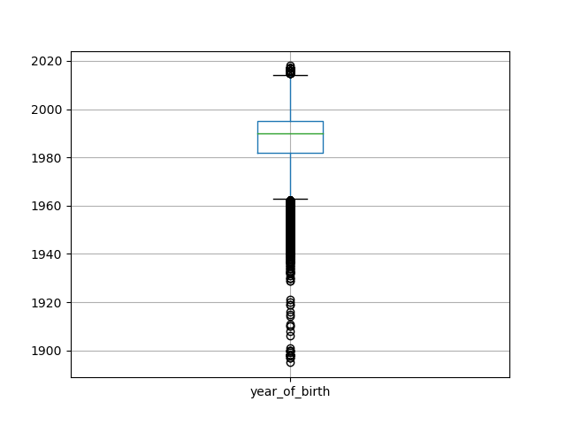

Data Cleanup: Null Removal
English - 93% null, dropped
Gender, Level of Education and US - preserved null
“u” (unspecified), -1
Year of Birth - replaced with median
Used box plots to see how it changed the data
Overall Impact
did not change Best Features
US and year of Birth lowest 2 correlated
Before null value removal
# Null
English 44381
year_of_birth 8828
level_of_education 8705
gender 7731
US 5694
After null value removal

Slide 10
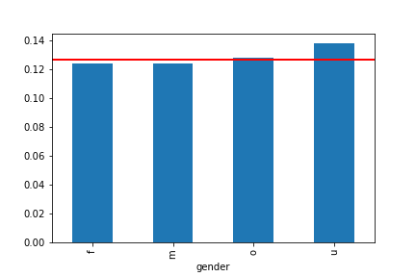
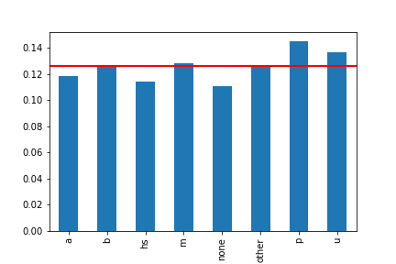
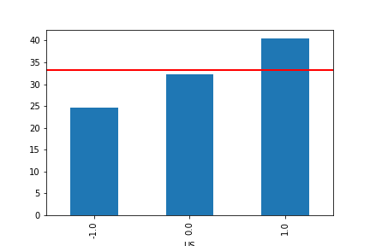
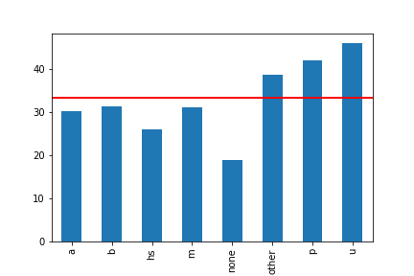
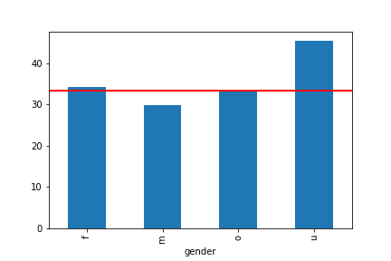
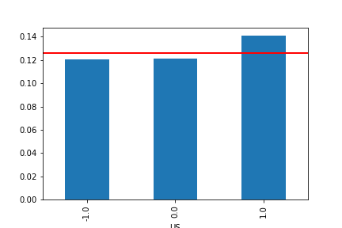
Data Cleanup: Null Removal
Correlation between null and Percent Progress and best features
Gender and Level of Education- higher
US - lower
Gender vs Percent Progress
Problem Graded
Level of Education vs Percent Progress
US
Level of Education
Gender
US vs Percent Progress

Slide 11
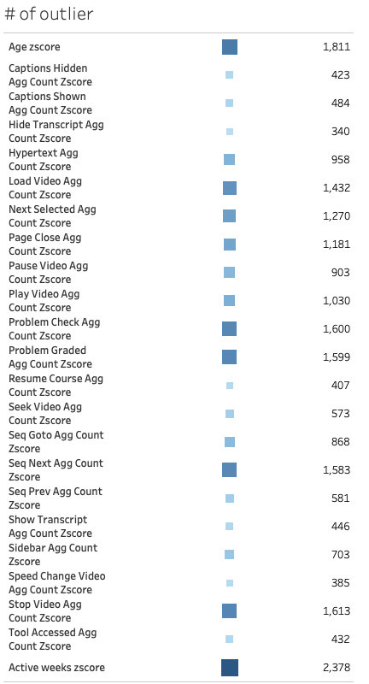
Data Cleanup: Outlier Removal
Procedure
Create dummy variable for category variables
Numerical variables:
Remove null
Box Plot to observe outliers
Create outlier table based on z-score
Remove absolute z-score >2
Validation
Visual Analysis
Outlier
Non-specified (Null) for gender and level of education
Other Insights

Slide 12
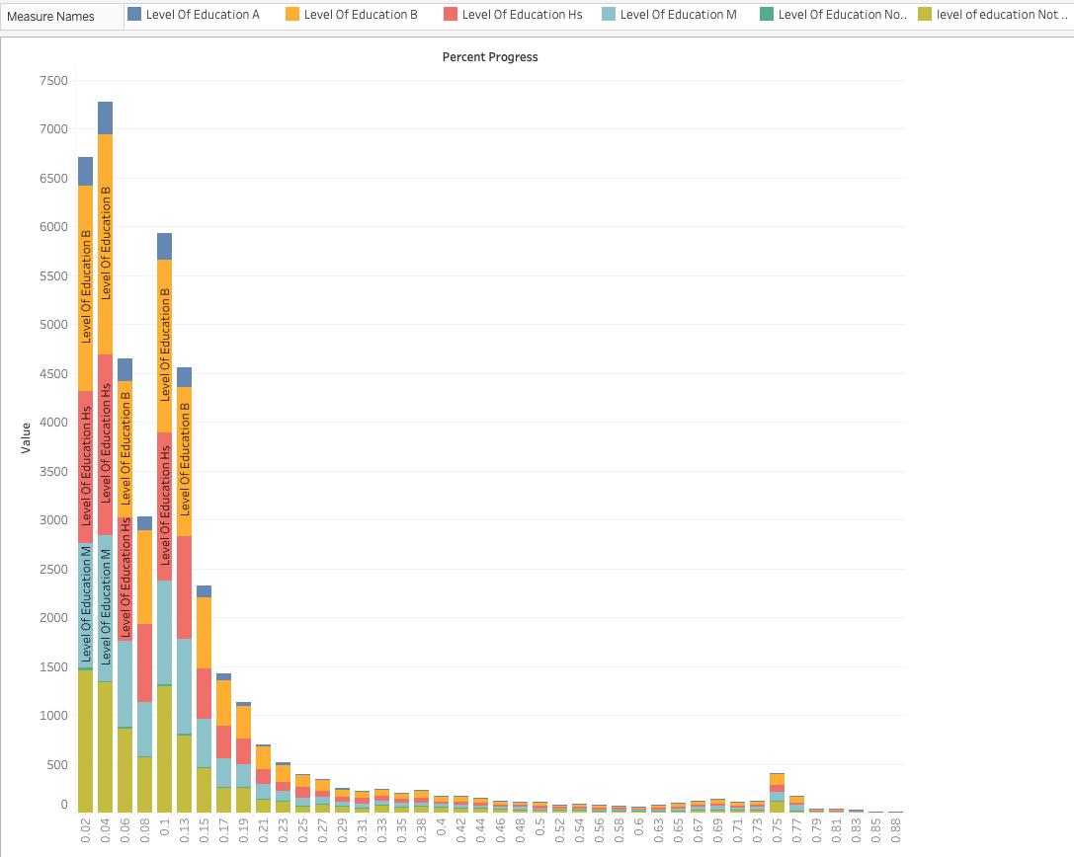
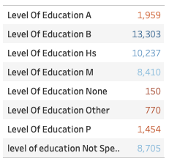
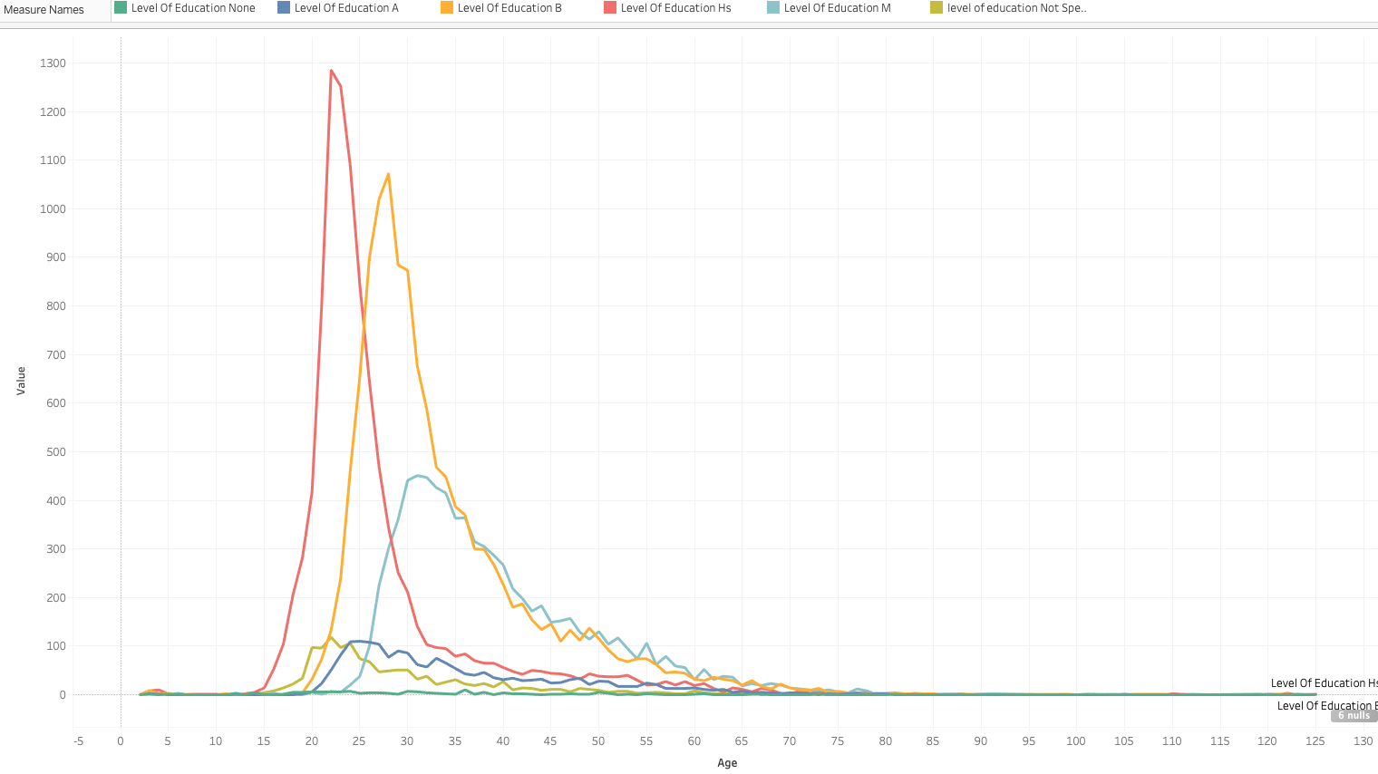
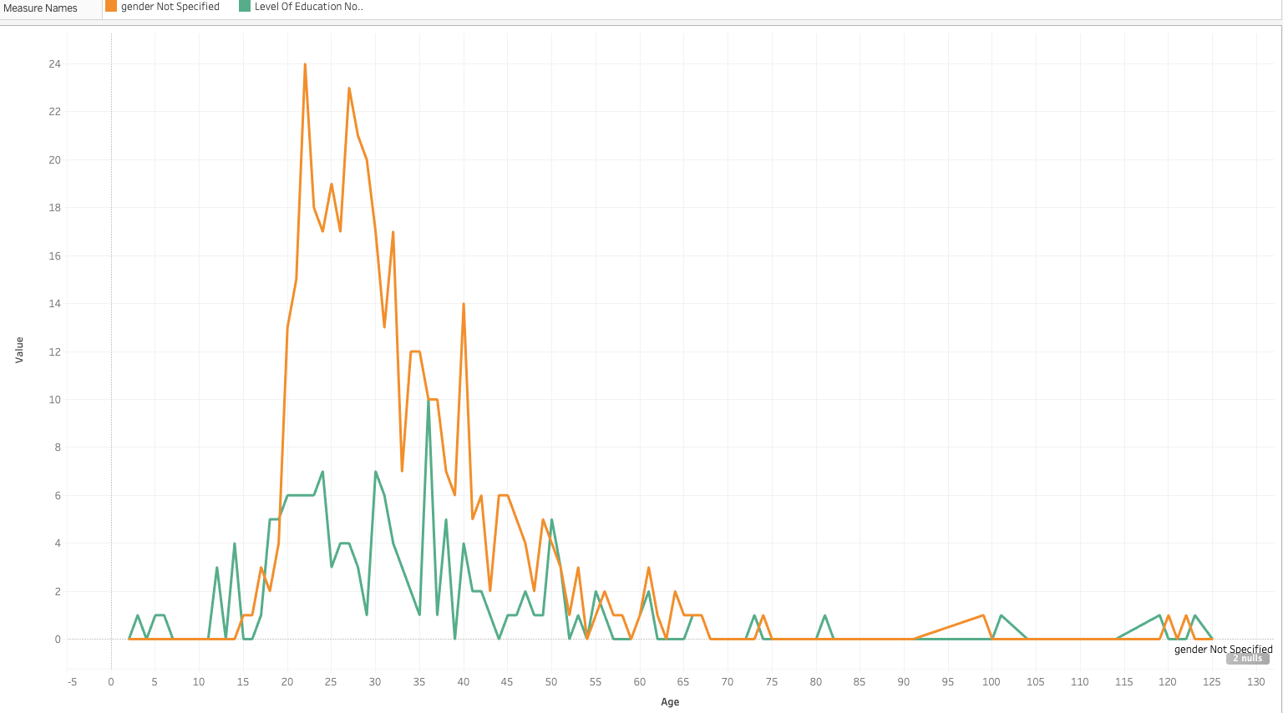
Level of Education
Most of students have high school or Bachelor degree
Student who not specified education level may associate with a lower percent of progress
High school graduation degree are in their age of 15-35
Age 20-30 may not likely to disclose their level of education and even more likely not disclose gender

Slide 13
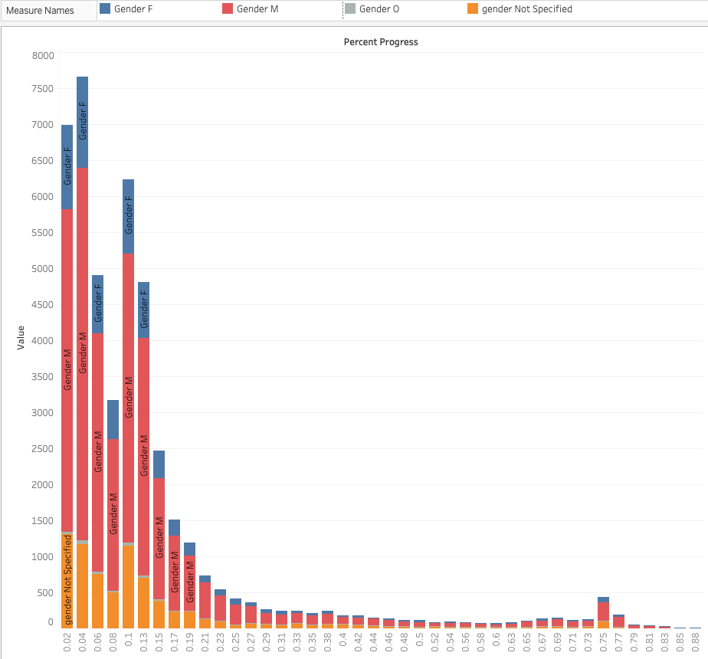
Gender
Gender distribution for percent of progress
Male has a highest percentage

Slide 14
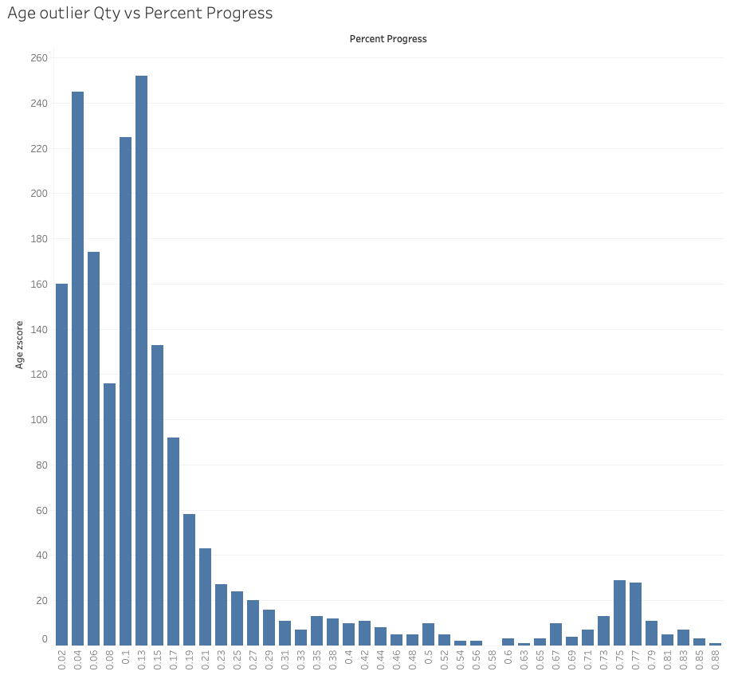
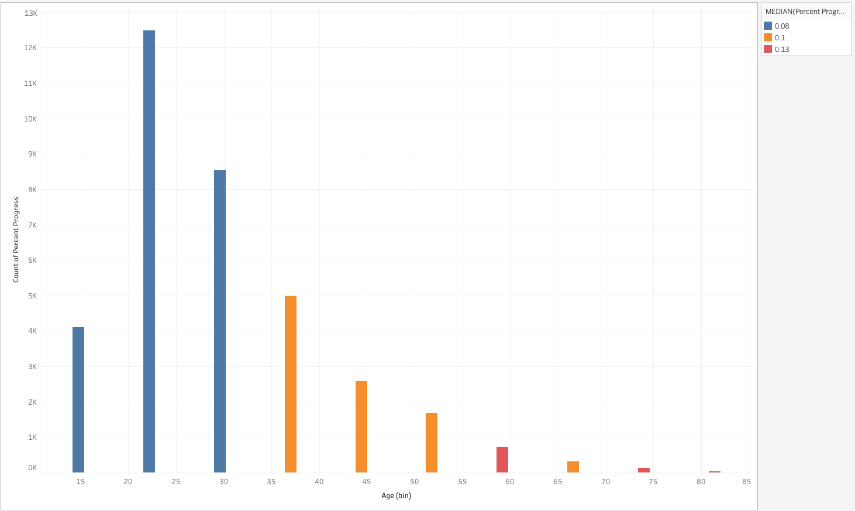
Age
Age outliers associate with low percent progress
Most of student are in age 20-45
Age > 35 are more likely to make progress. 60 and 75 have the highest percent of progress

Slide 15
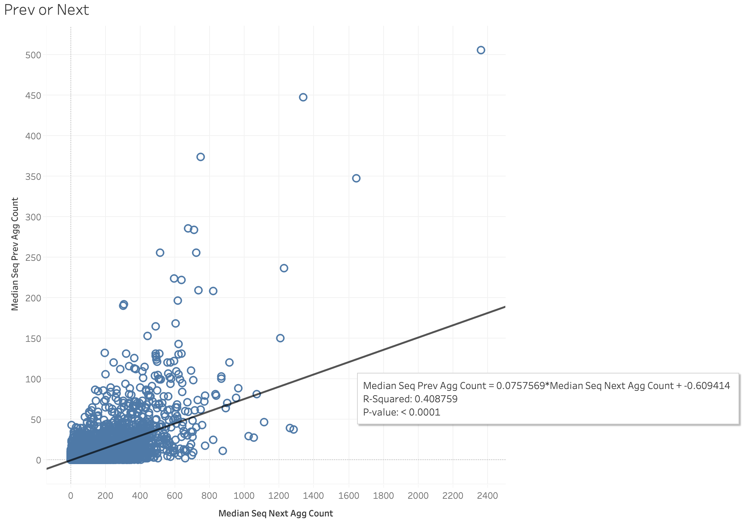
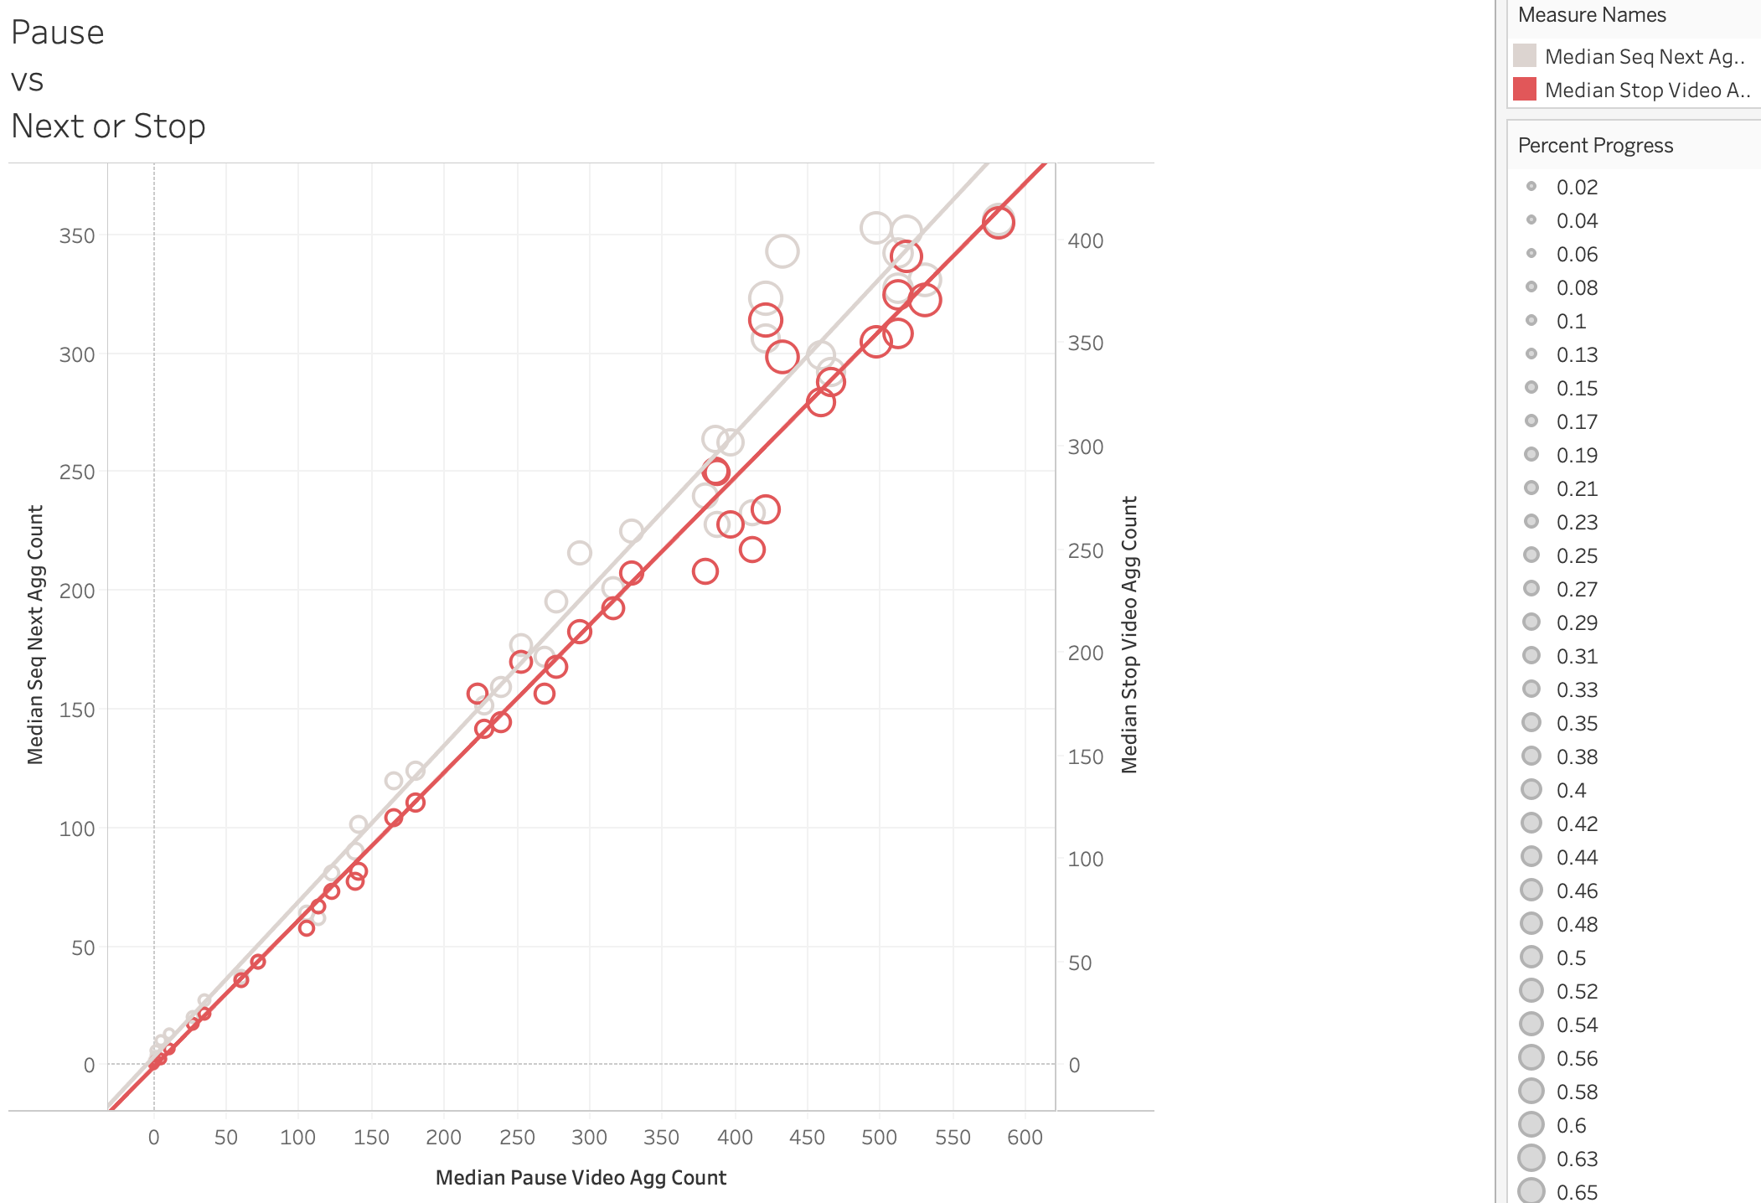
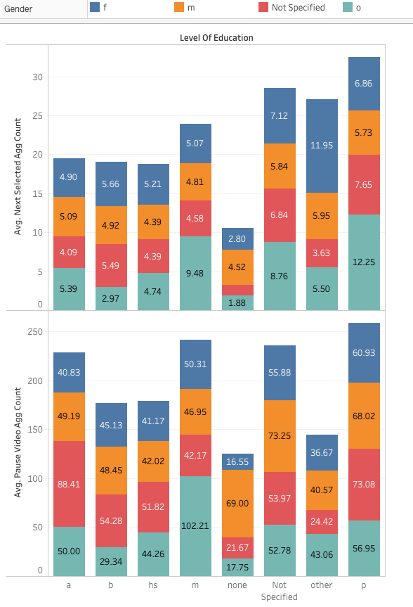
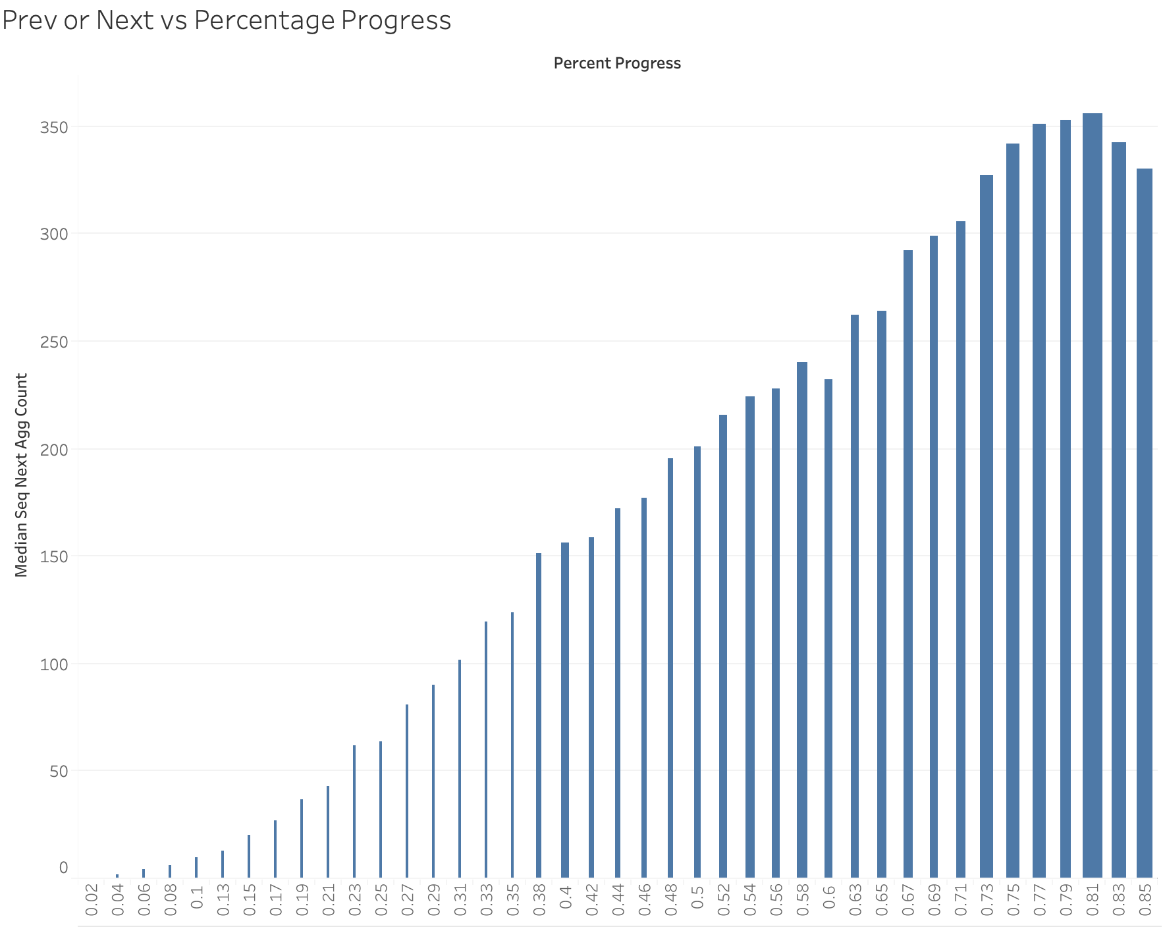
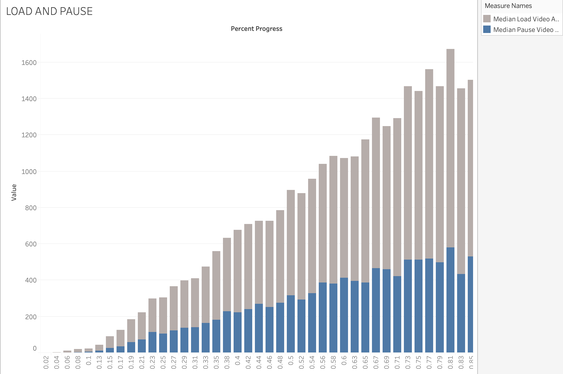
Behavior
Next or Pause on age and education
Pause vs Next or Stop
Pause vs Load
Next & Prev vs Percent of Progress

Slide 16
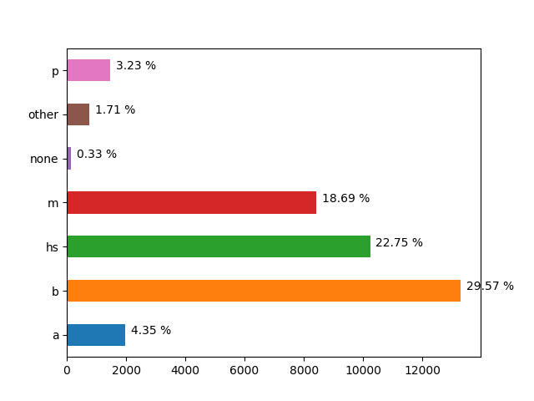
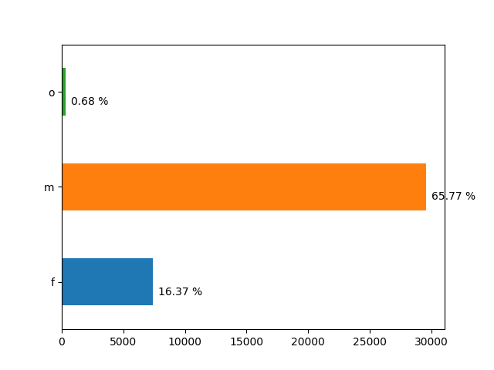
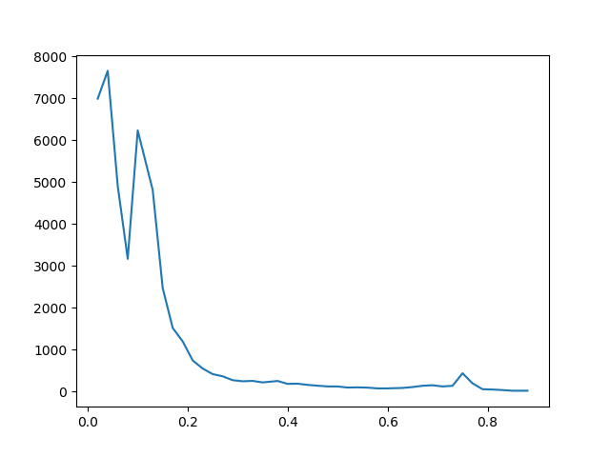
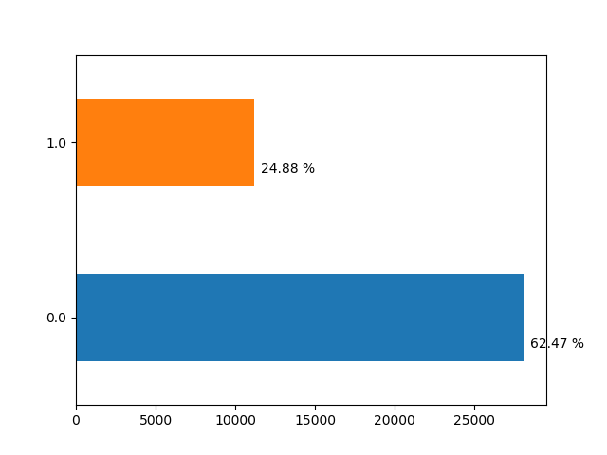
Demographics Data
65% Male
30% B degree
62% Non-US
Very low percentage completed more than 20%

Slide 17
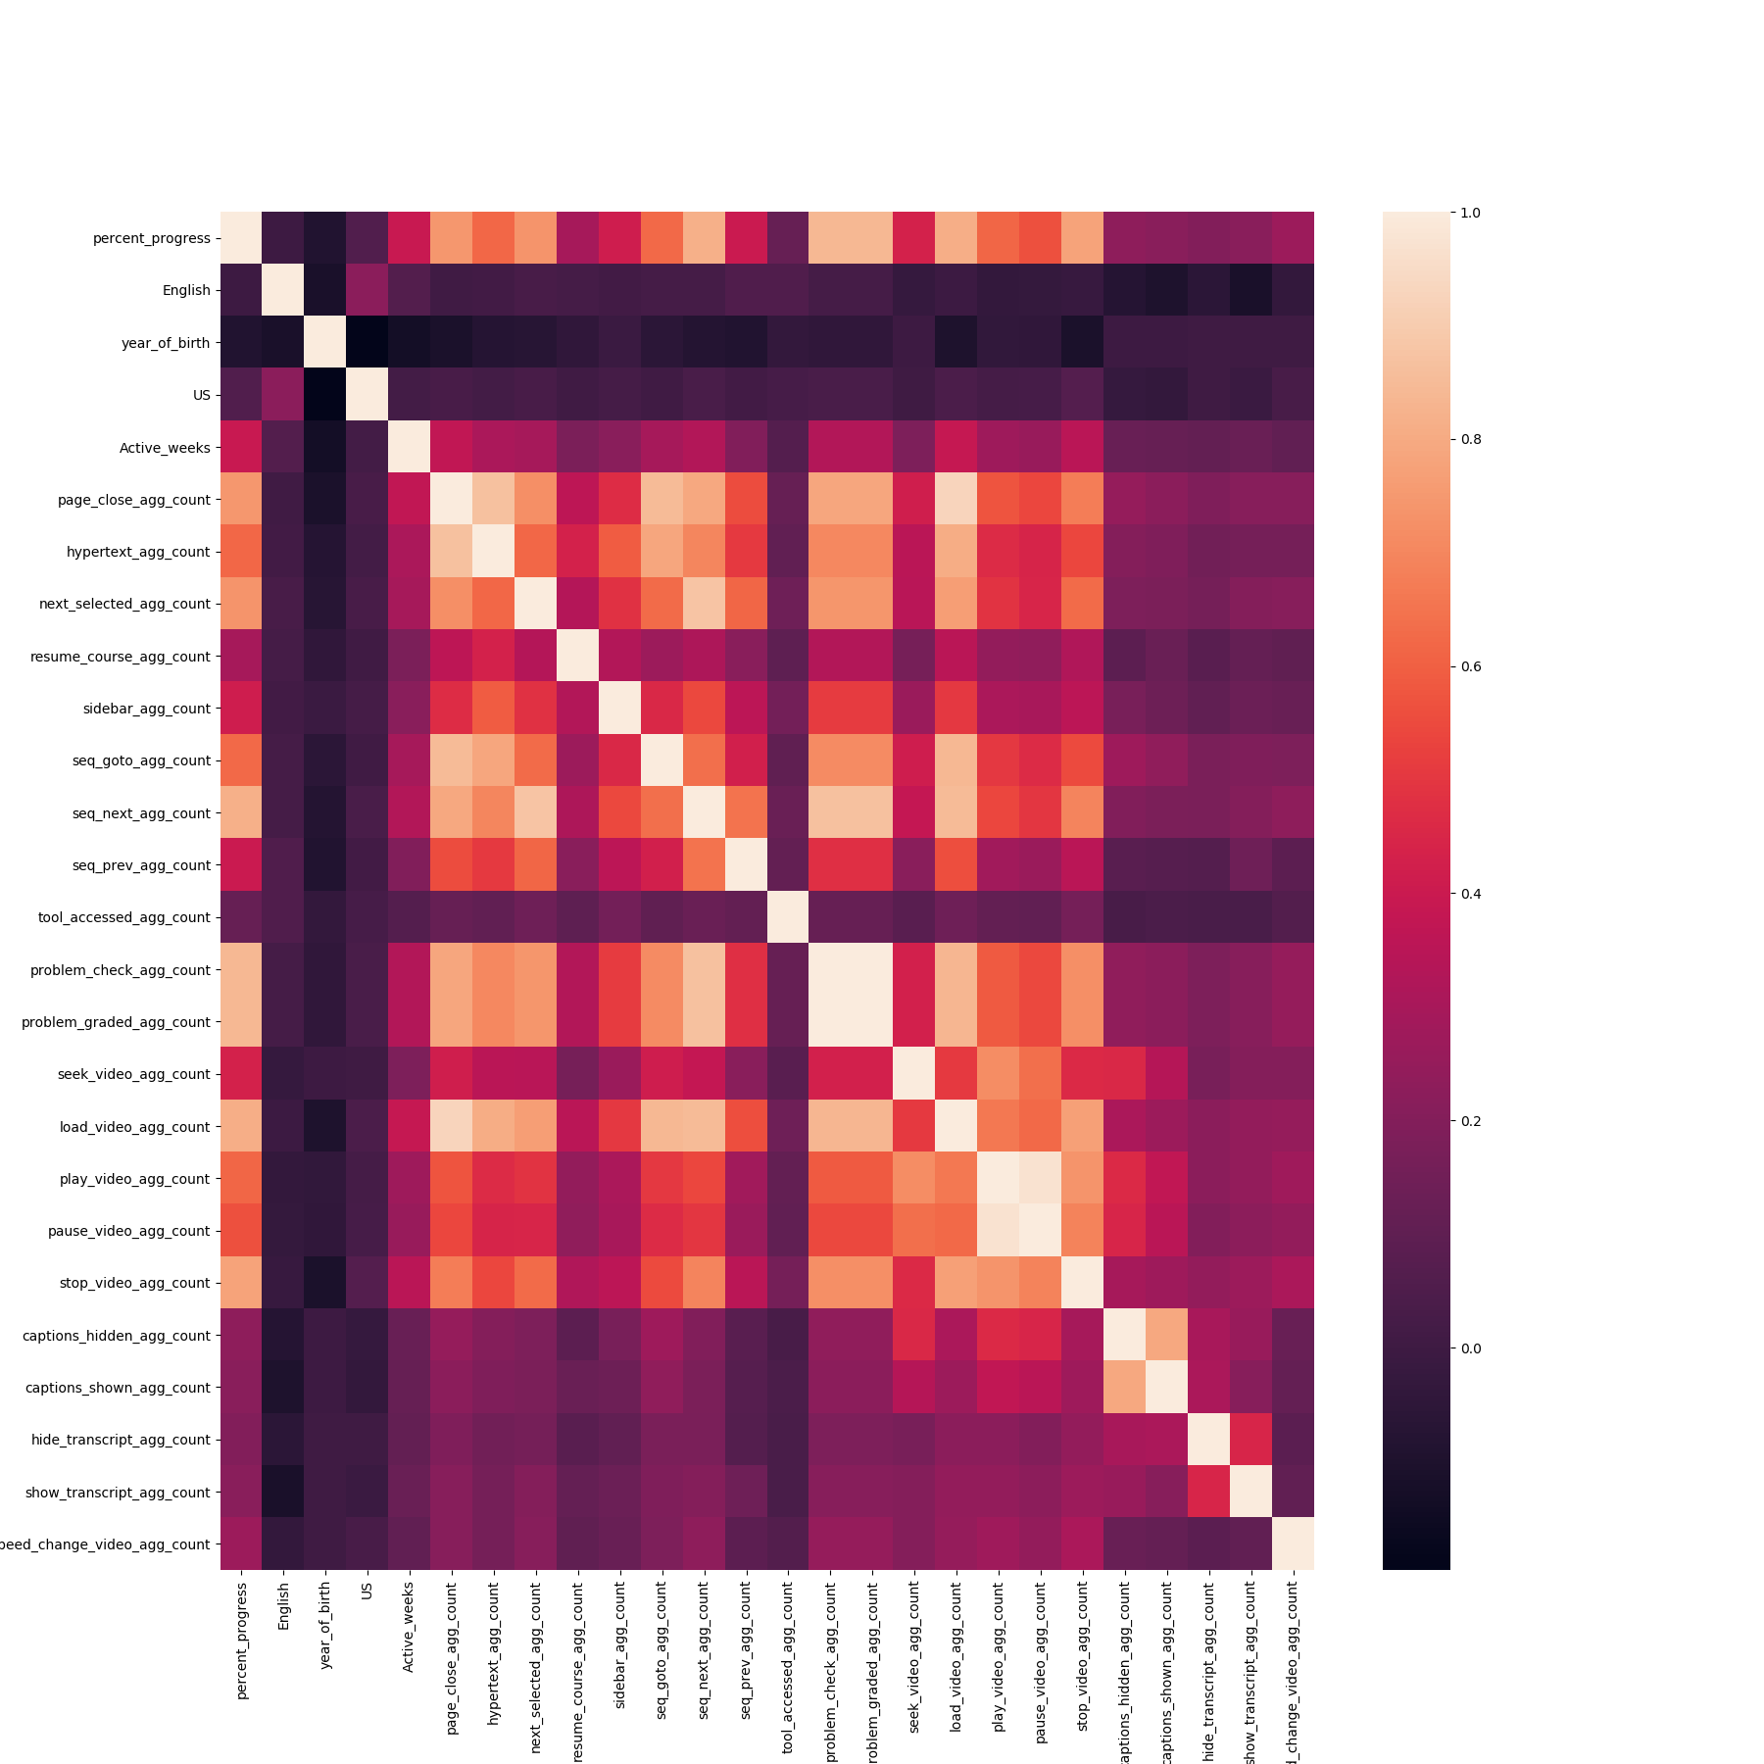
Feature Correlation
Best features
Problem Graded
Problem Check
Next Seq
Video Load
Stop Video
Problem Check and Problem Graded are highly correlated
Play Video and Pause Video are highly correlated.

Slide 18
Data Modeling: Next Steps
What we are working on now:
Applying various modeling algorithm
Finding the best features for the model.
Our goals for the semester:
Find interesting data Insights from the MOOC data (Completed)
Find best features to use (In Progress)
Find the best fit model to predict the percentage of complete(In Progress)
Stretch Goal: Run unsupervised learning to find interesting clusters.
Notes:
Attush Dhakal

Slide 19
Web Development Team

Slide 20
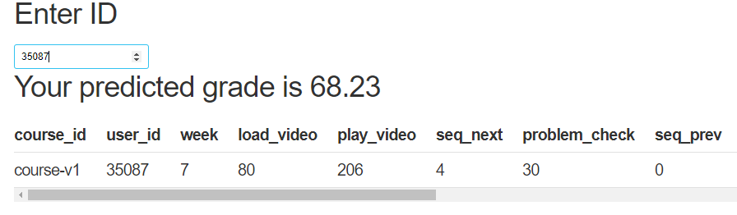
Front-end: Things done
Added a home button and navigation sidebar
Added resources (tutoring, advising, professor directory)
Connected to a online SQL database with dummy data
Displays that data in a table
Added ID specific tables
Connected to dummy model to display new predicted student grade

Slide 21
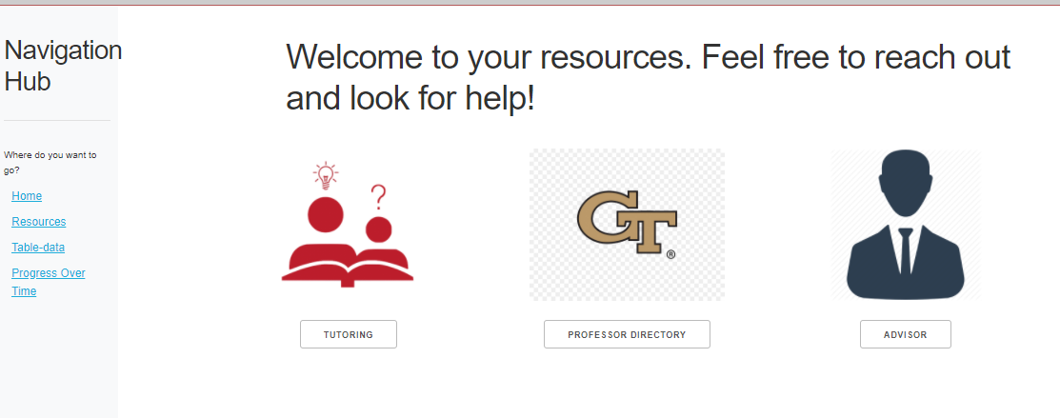
Front-end: Things to be done
Achieve base-mockup design (as much as possible)
Start putting that design onto the app
Integrate model team’s plots
Real model prediction

Slide 22
Front-end: Web App Mockups
Wireframe is ready for Web-app
Figma Link
We will derive another mock-up for this semester based on final mock-up

Slide 23
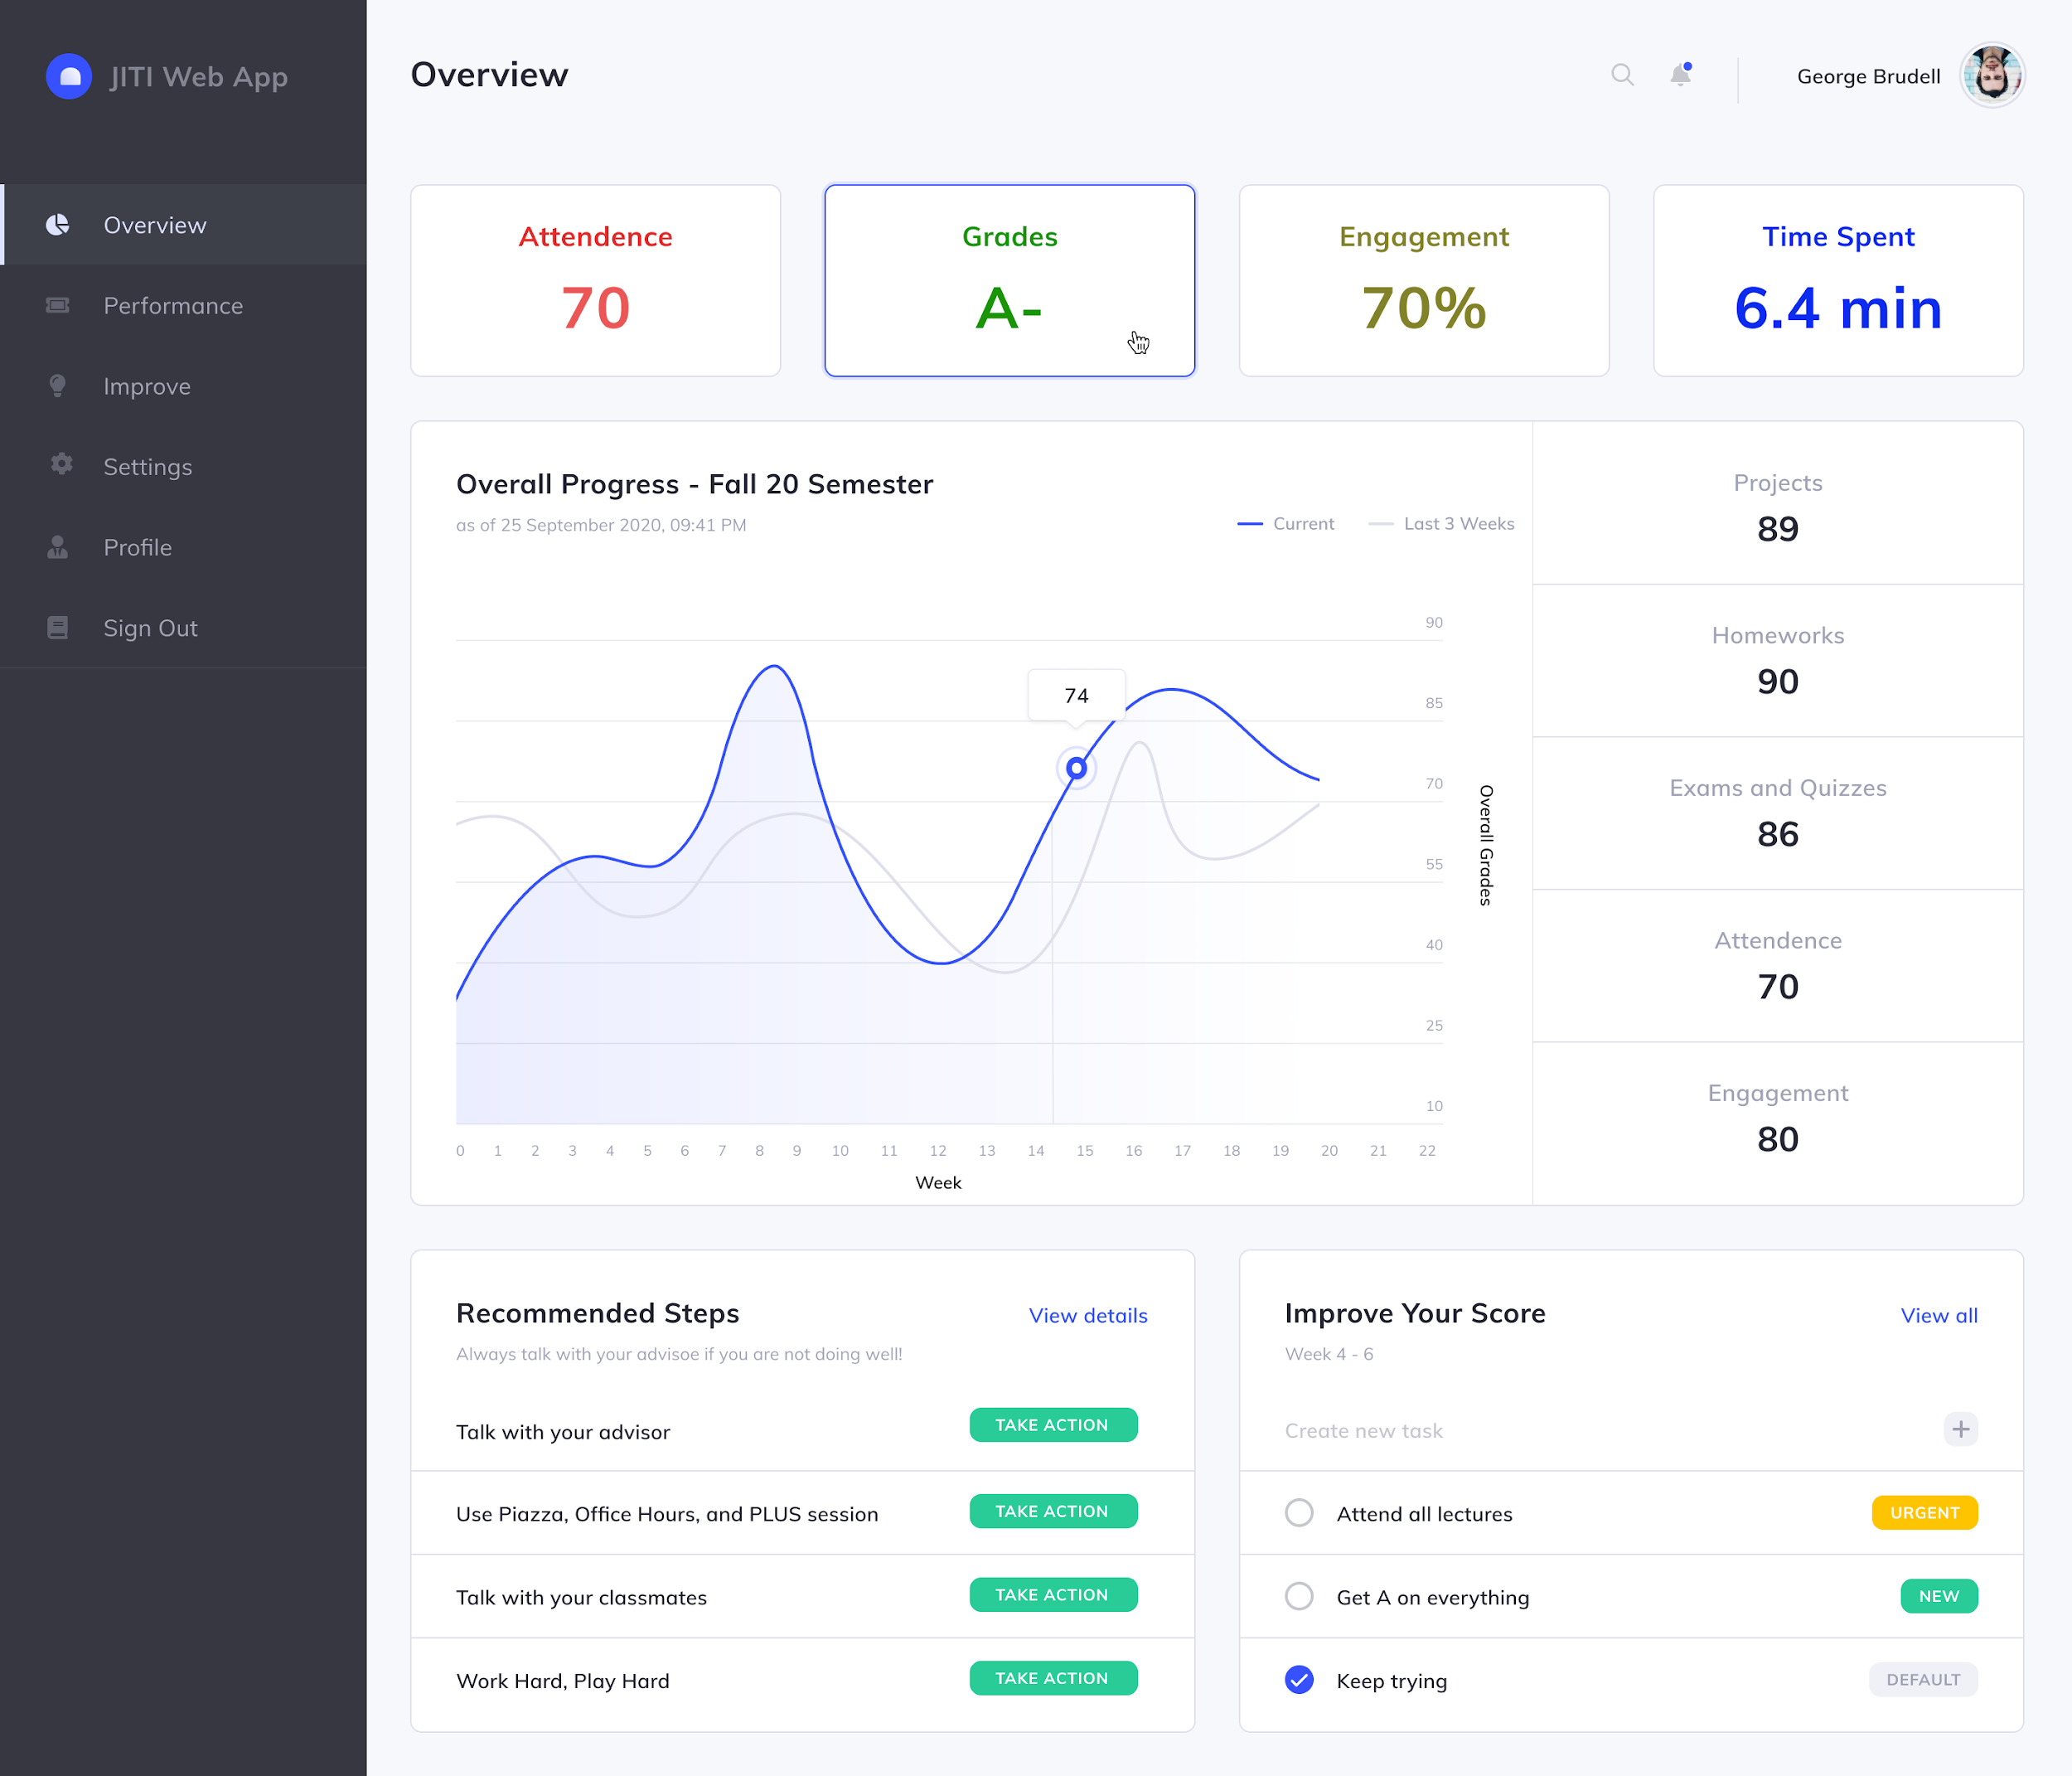

Slide 24
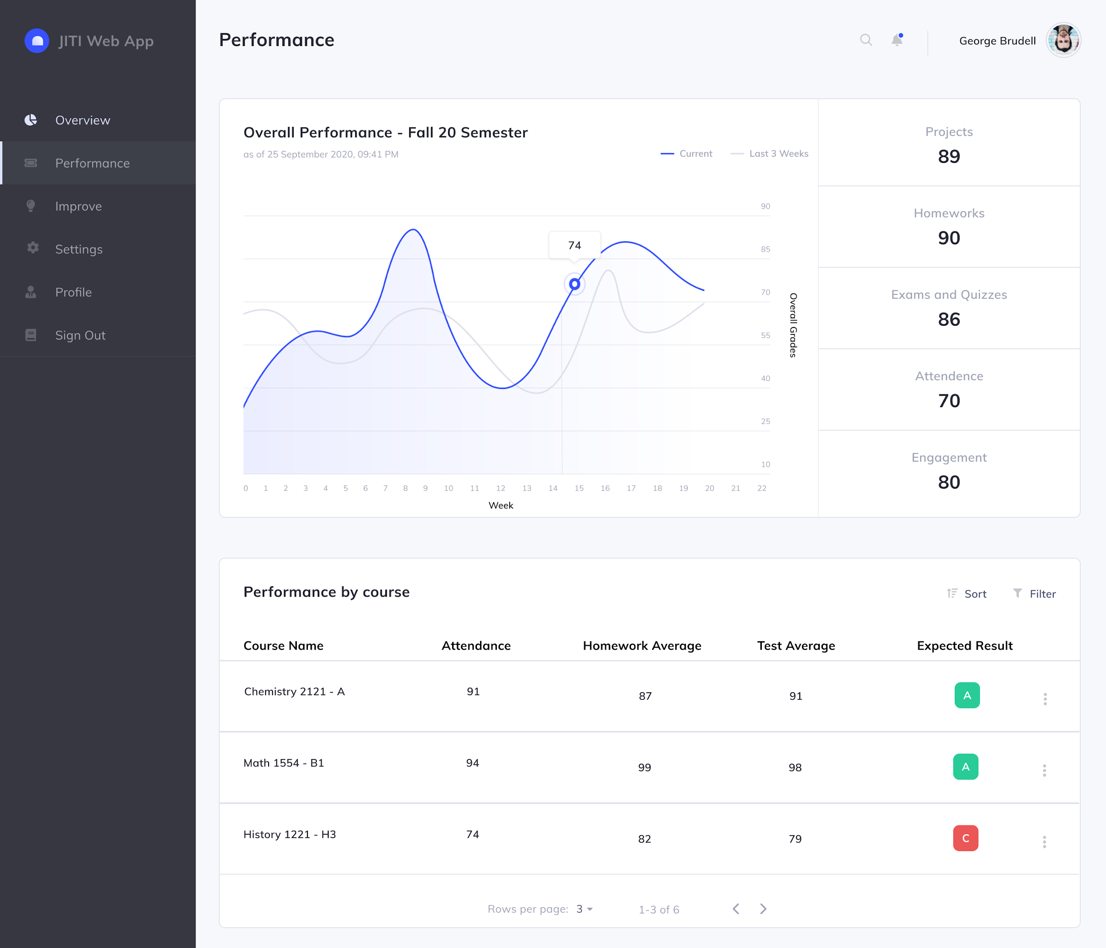

Slide 25
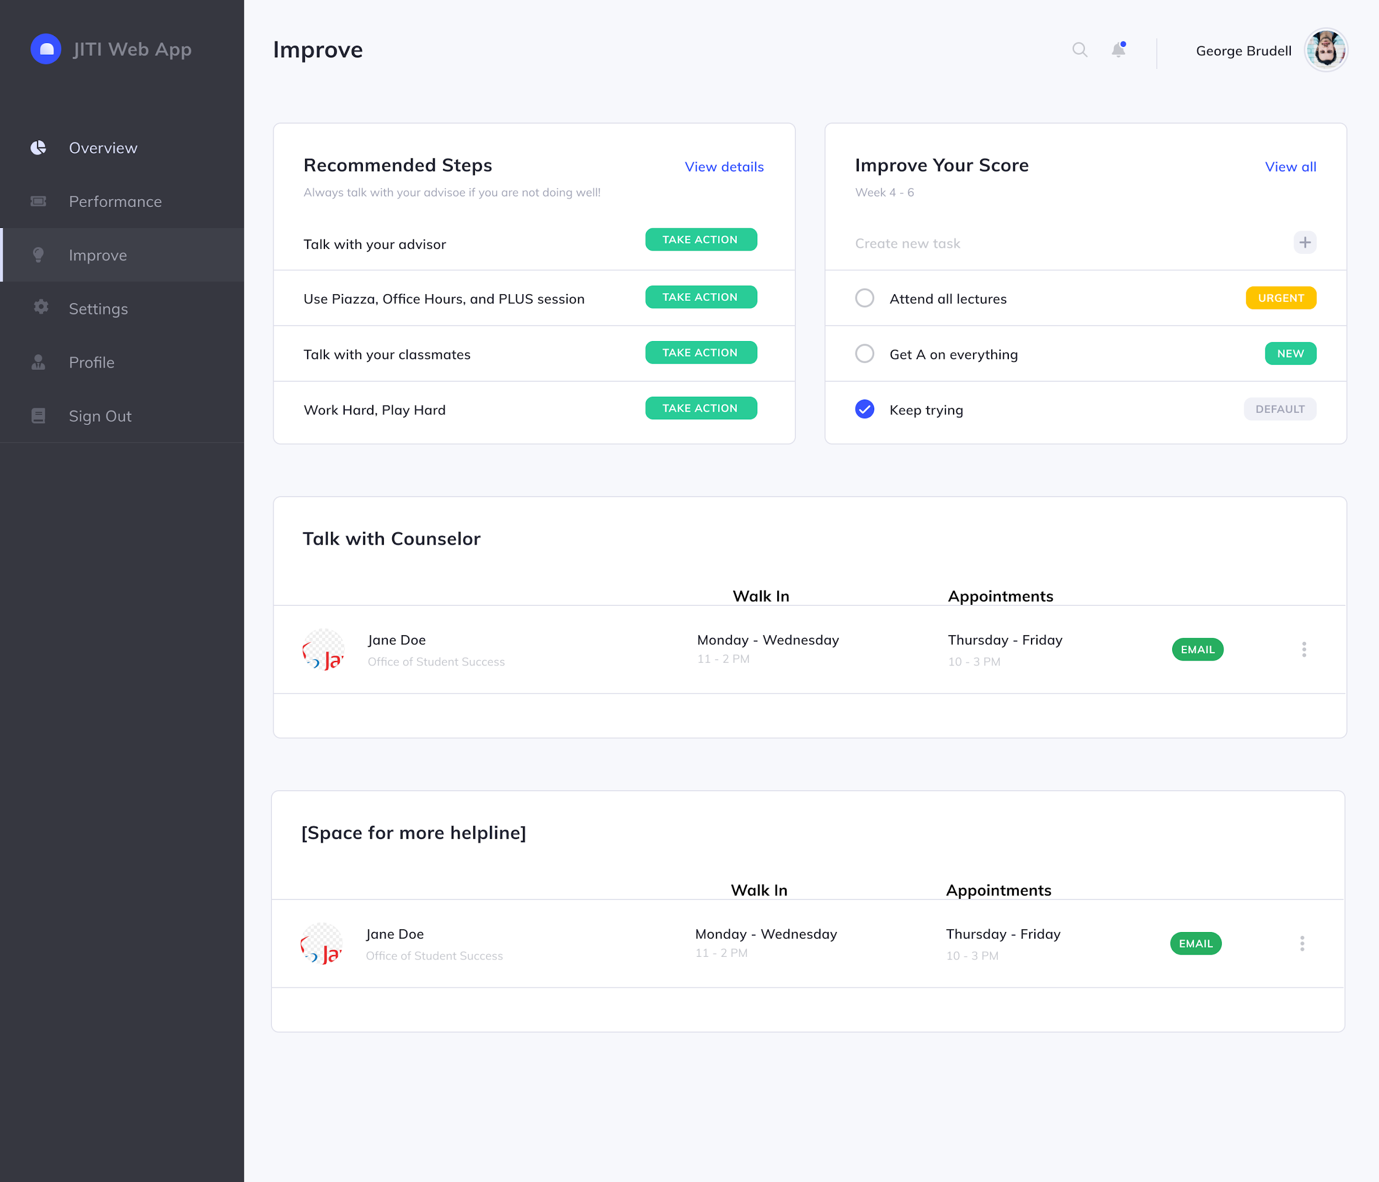

Slide 26
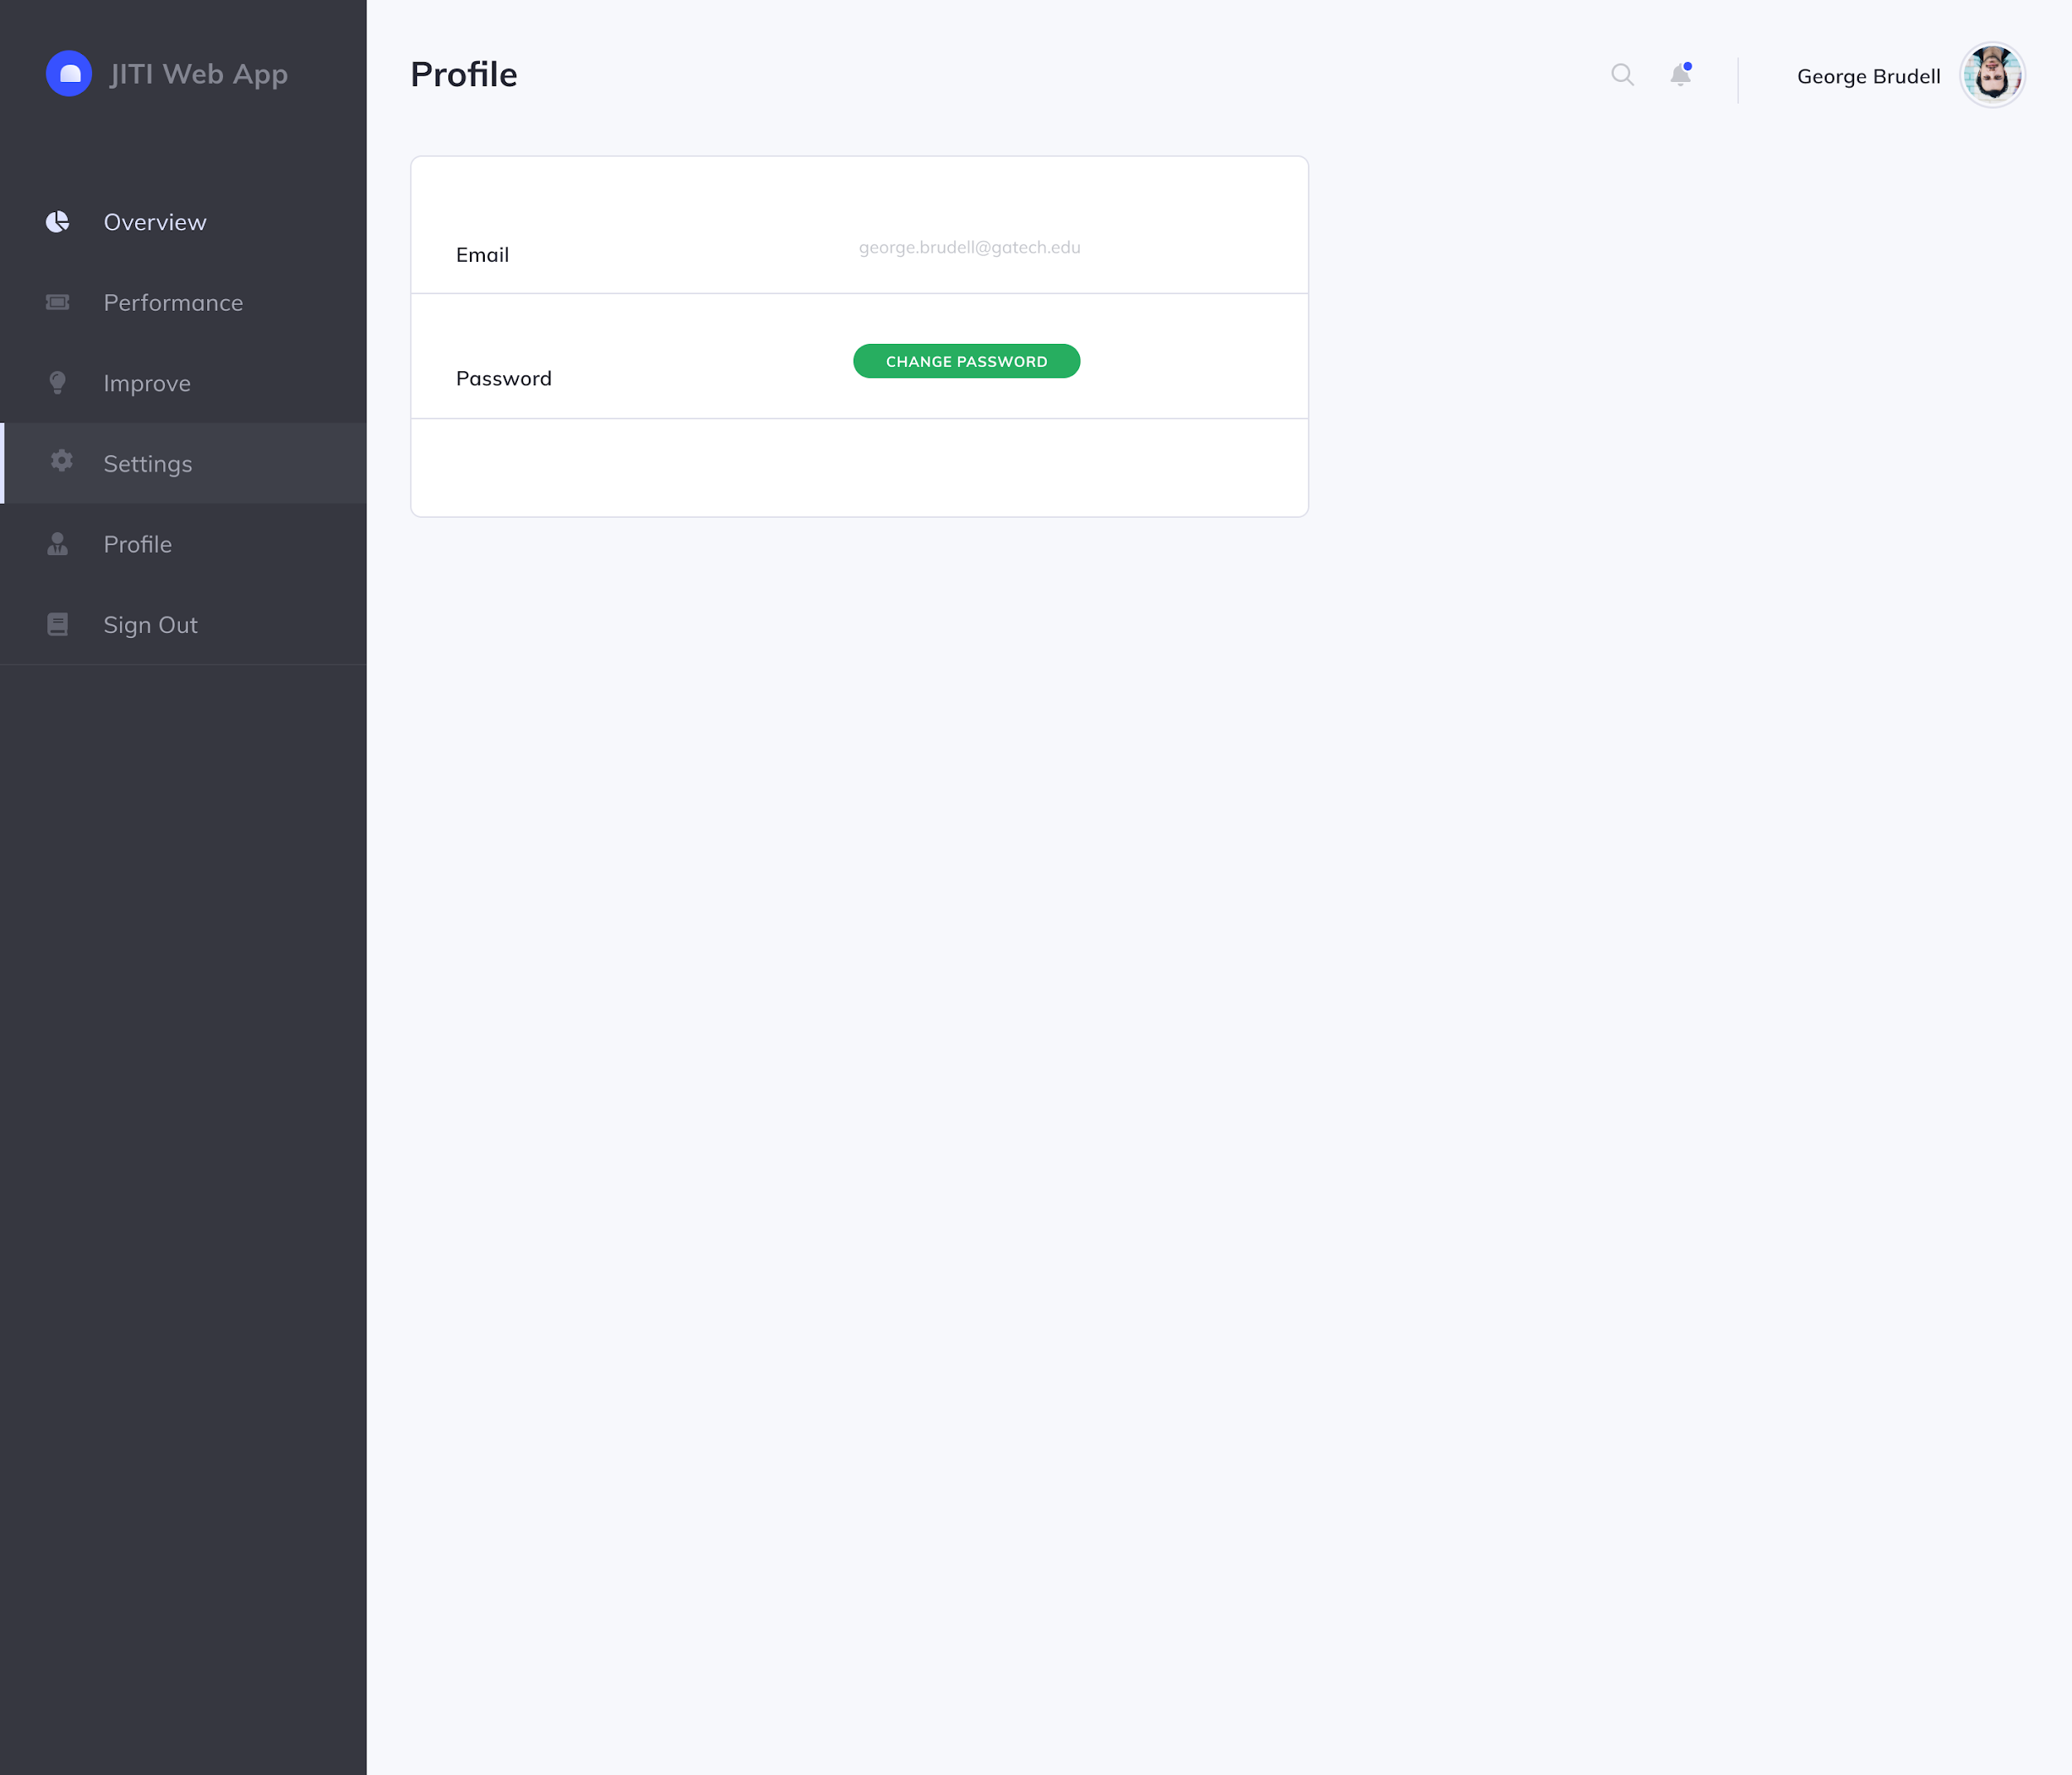
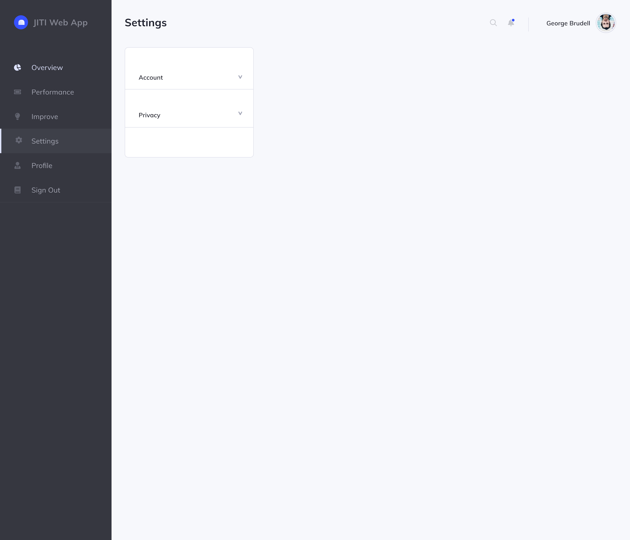

Slide 27
Back-end: Progress since last presentation
Temporarily updated dummy db to match C21U data better
Currently getting data from C21U’s database
Refactored code to make it more compatible with connecting to C21U db
Created a local dummy model (weights in a csv file)
Created a function that is able to receive student data and apply the dummy model to the data
Created more functions needed by frontend to be able to present the data properly (i.e. getting table’s column names, exporting table to dataframe)
Made clear and complete documentation for the functions

Slide 28
Back-end: Next Steps
What we are working on now:
Improve dummy model function so we can easily pass what columns to apply the model to
Continue creating functions to help frontend easily get the data necessary
Our goals for the semester:
Connect web app with C21U DB (Completed)
Write functions to assist with query as needed by the Front-end (In Progress, No Problems)
Display student under risk factors and indicators
Build email notification that triggers when specified criteria is met (Reach Goal)
Notes:
Attush Dhakal

Slide 29
Thank you!!

